Slide 1
Image Captioning with Deep Bidirectional LSTMs
汇报人：罗铃皓
2023.11.3
Cheng Wang, Haojin Yang, Christian Bartz, Christoph Meinel
Hasso Plattner Institute, University of Potsdam
Prof.-Dr.-Helmert-Str. 2-3, 14482 Potsdam, Germany
{cheng.wang, haojin.yang,christoph.meinel}@hpi.de christian.bartz@student.hpi.uni-potsdam.de
ACM International Conference on Multimedia (MM)（2016）CCF A
引用307

Slide 2
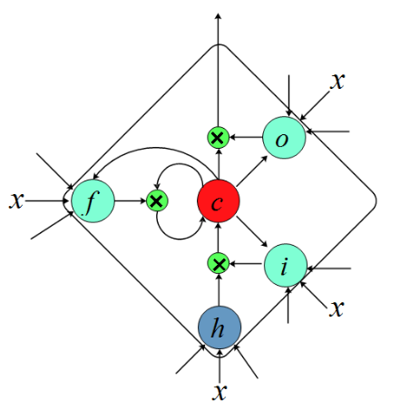
原图
复现
x
o
e
x
f
c
i
x
h
x
Long Short Term Memory (LSTM) cell.

Slide 3
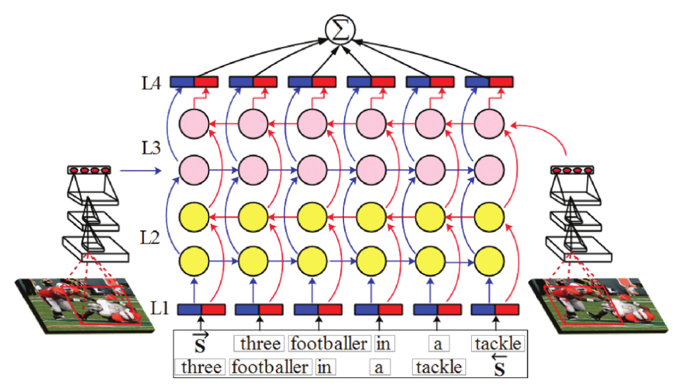
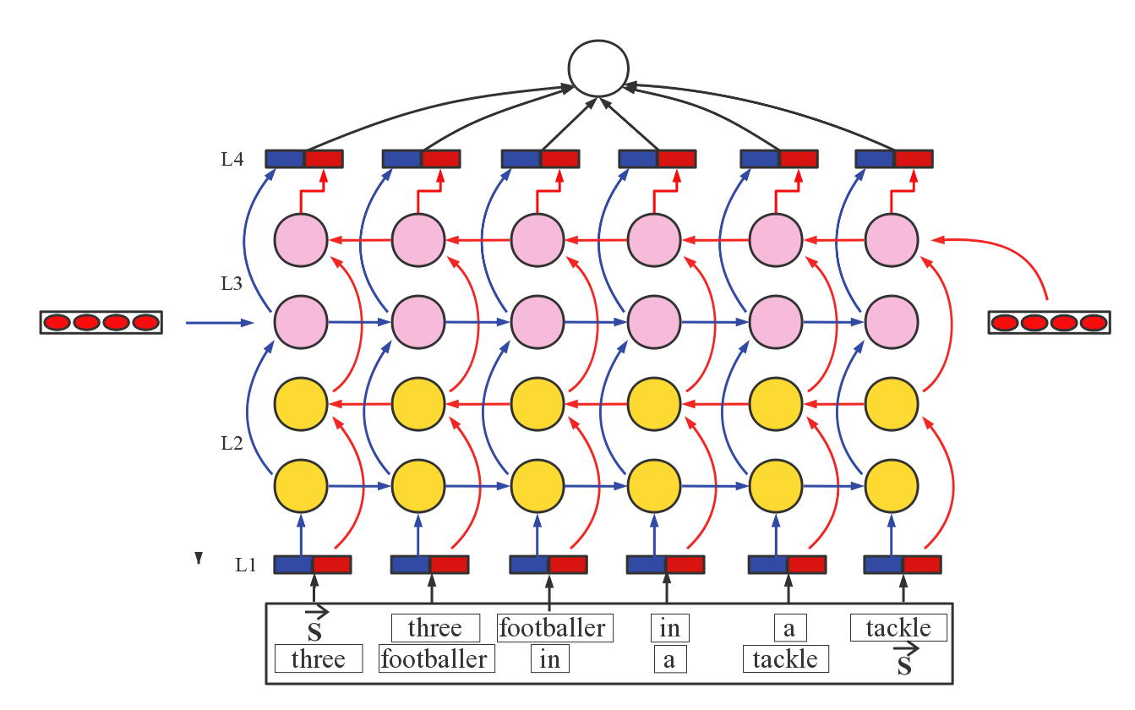
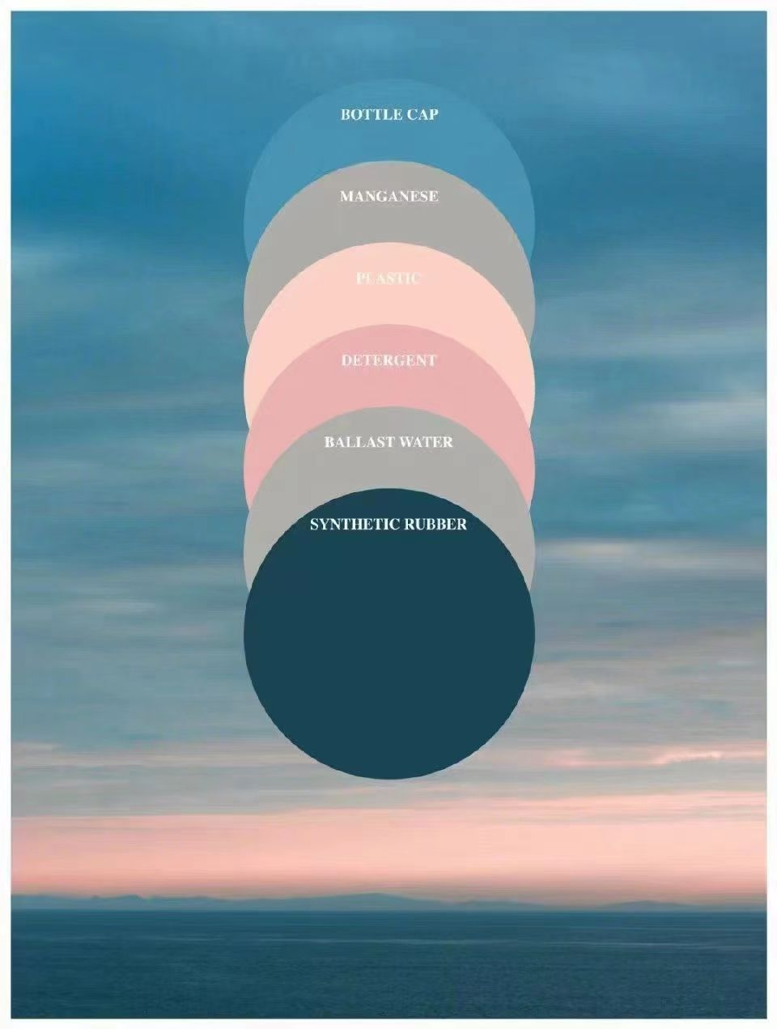
原图
复现
∑
Deep Multimodal Bidirectional LSTM

Slide 4
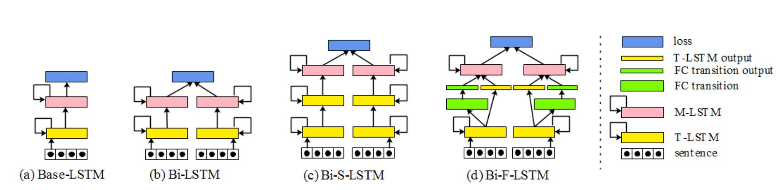
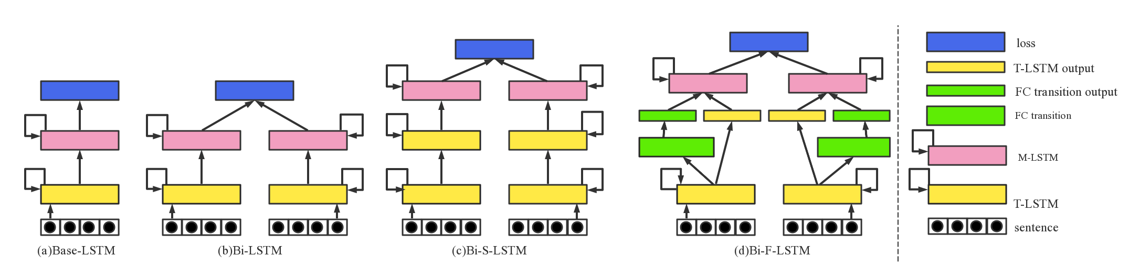
原图
复现
Base LSTM
Bidirectional LSTM
Bidirectional Stacked LSTM
Bidirectional LSTM with fully connected (FC) transition layer

